Slide 1

Hybrid-Granularity Image-Music Retrieval Using Contrastive Learning Between Images and Music
Xudong He, Li Wang*, Zhao Wang, Jun Xiao
Zhejiang University, China

Slide 2




Image-based Music Retrieval
Query
Result

Slide 3
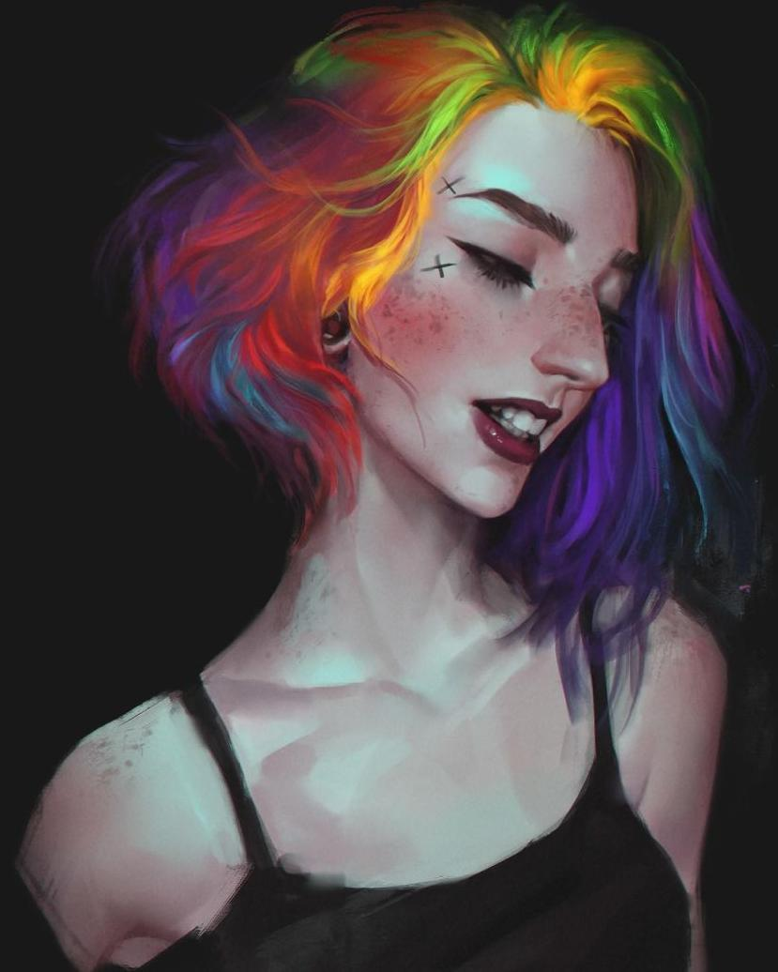
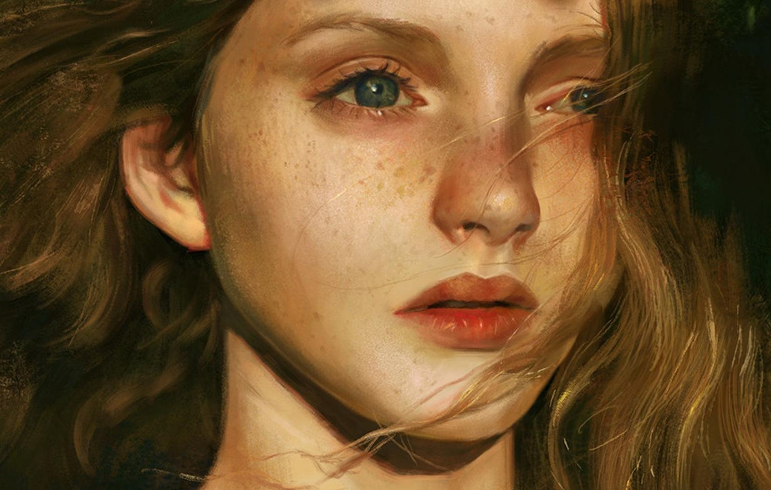

Music-based Image Retrieval
Query
Result

Slide 4
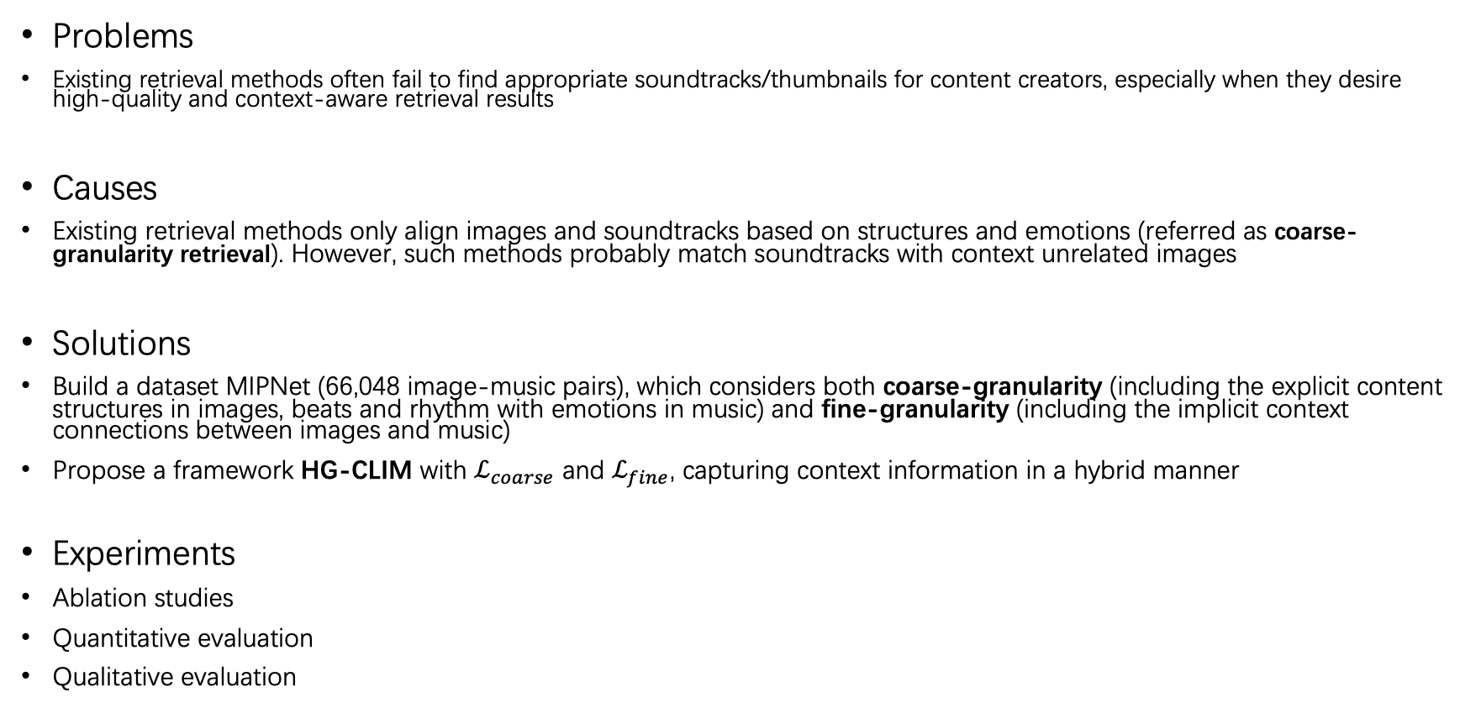
Outlines
Problems
Existing retrieval methods often fail to find appropriate soundtracks/thumbnails for content creators, especially when they desire high-quality and context-aware retrieval results
Causes
Existing retrieval methods only align images and soundtracks based on structures and emotions (referred as coarse-granularity retrieval). However, such methods probably match soundtracks with context unrelated images
Solutions
Build a dataset MIPNet (66,048 image-music pairs), which considers both coarse-granularity (including the explicit content structures in images, beats and rhythm with emotions in music) and fine-granularity (including the implicit context connections between images and music)
Propose a framework HG-CLIM with $ℒ_{coarse}$ and $ℒ_{fine}$, capturing context information in a hybrid manner
Experiments
Ablation studies
Quantitative evaluation
Qualitative evaluation

Slide 5
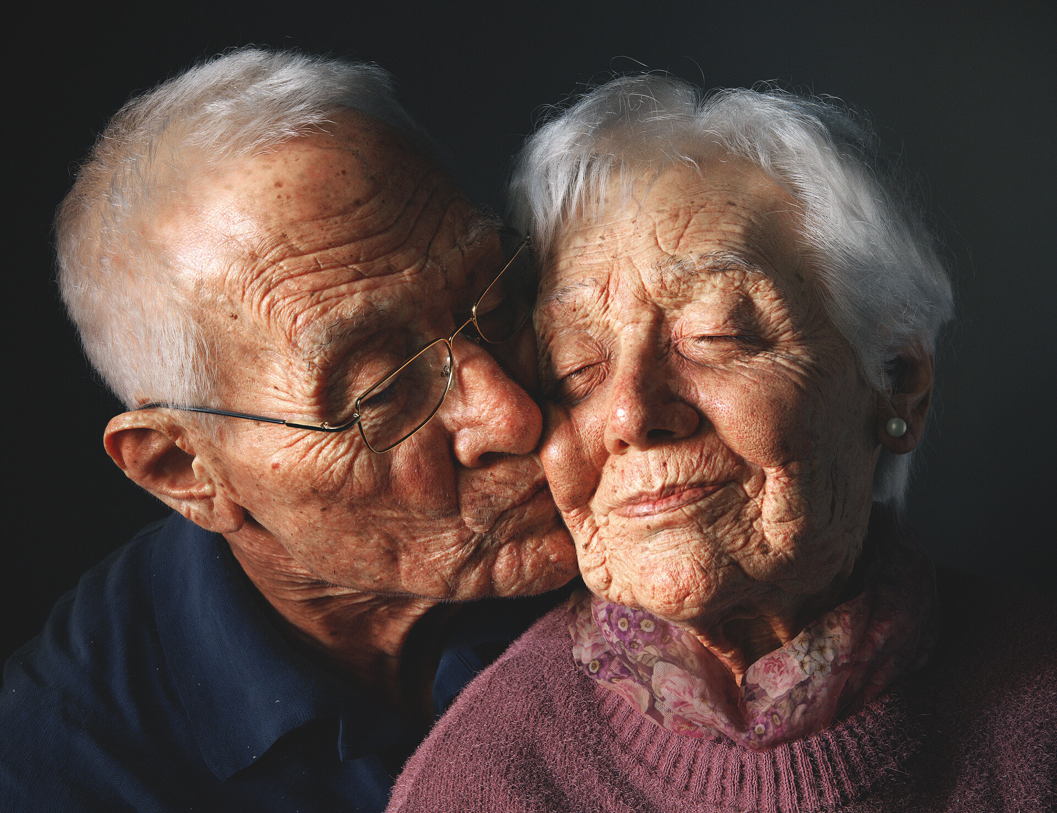



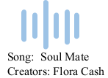

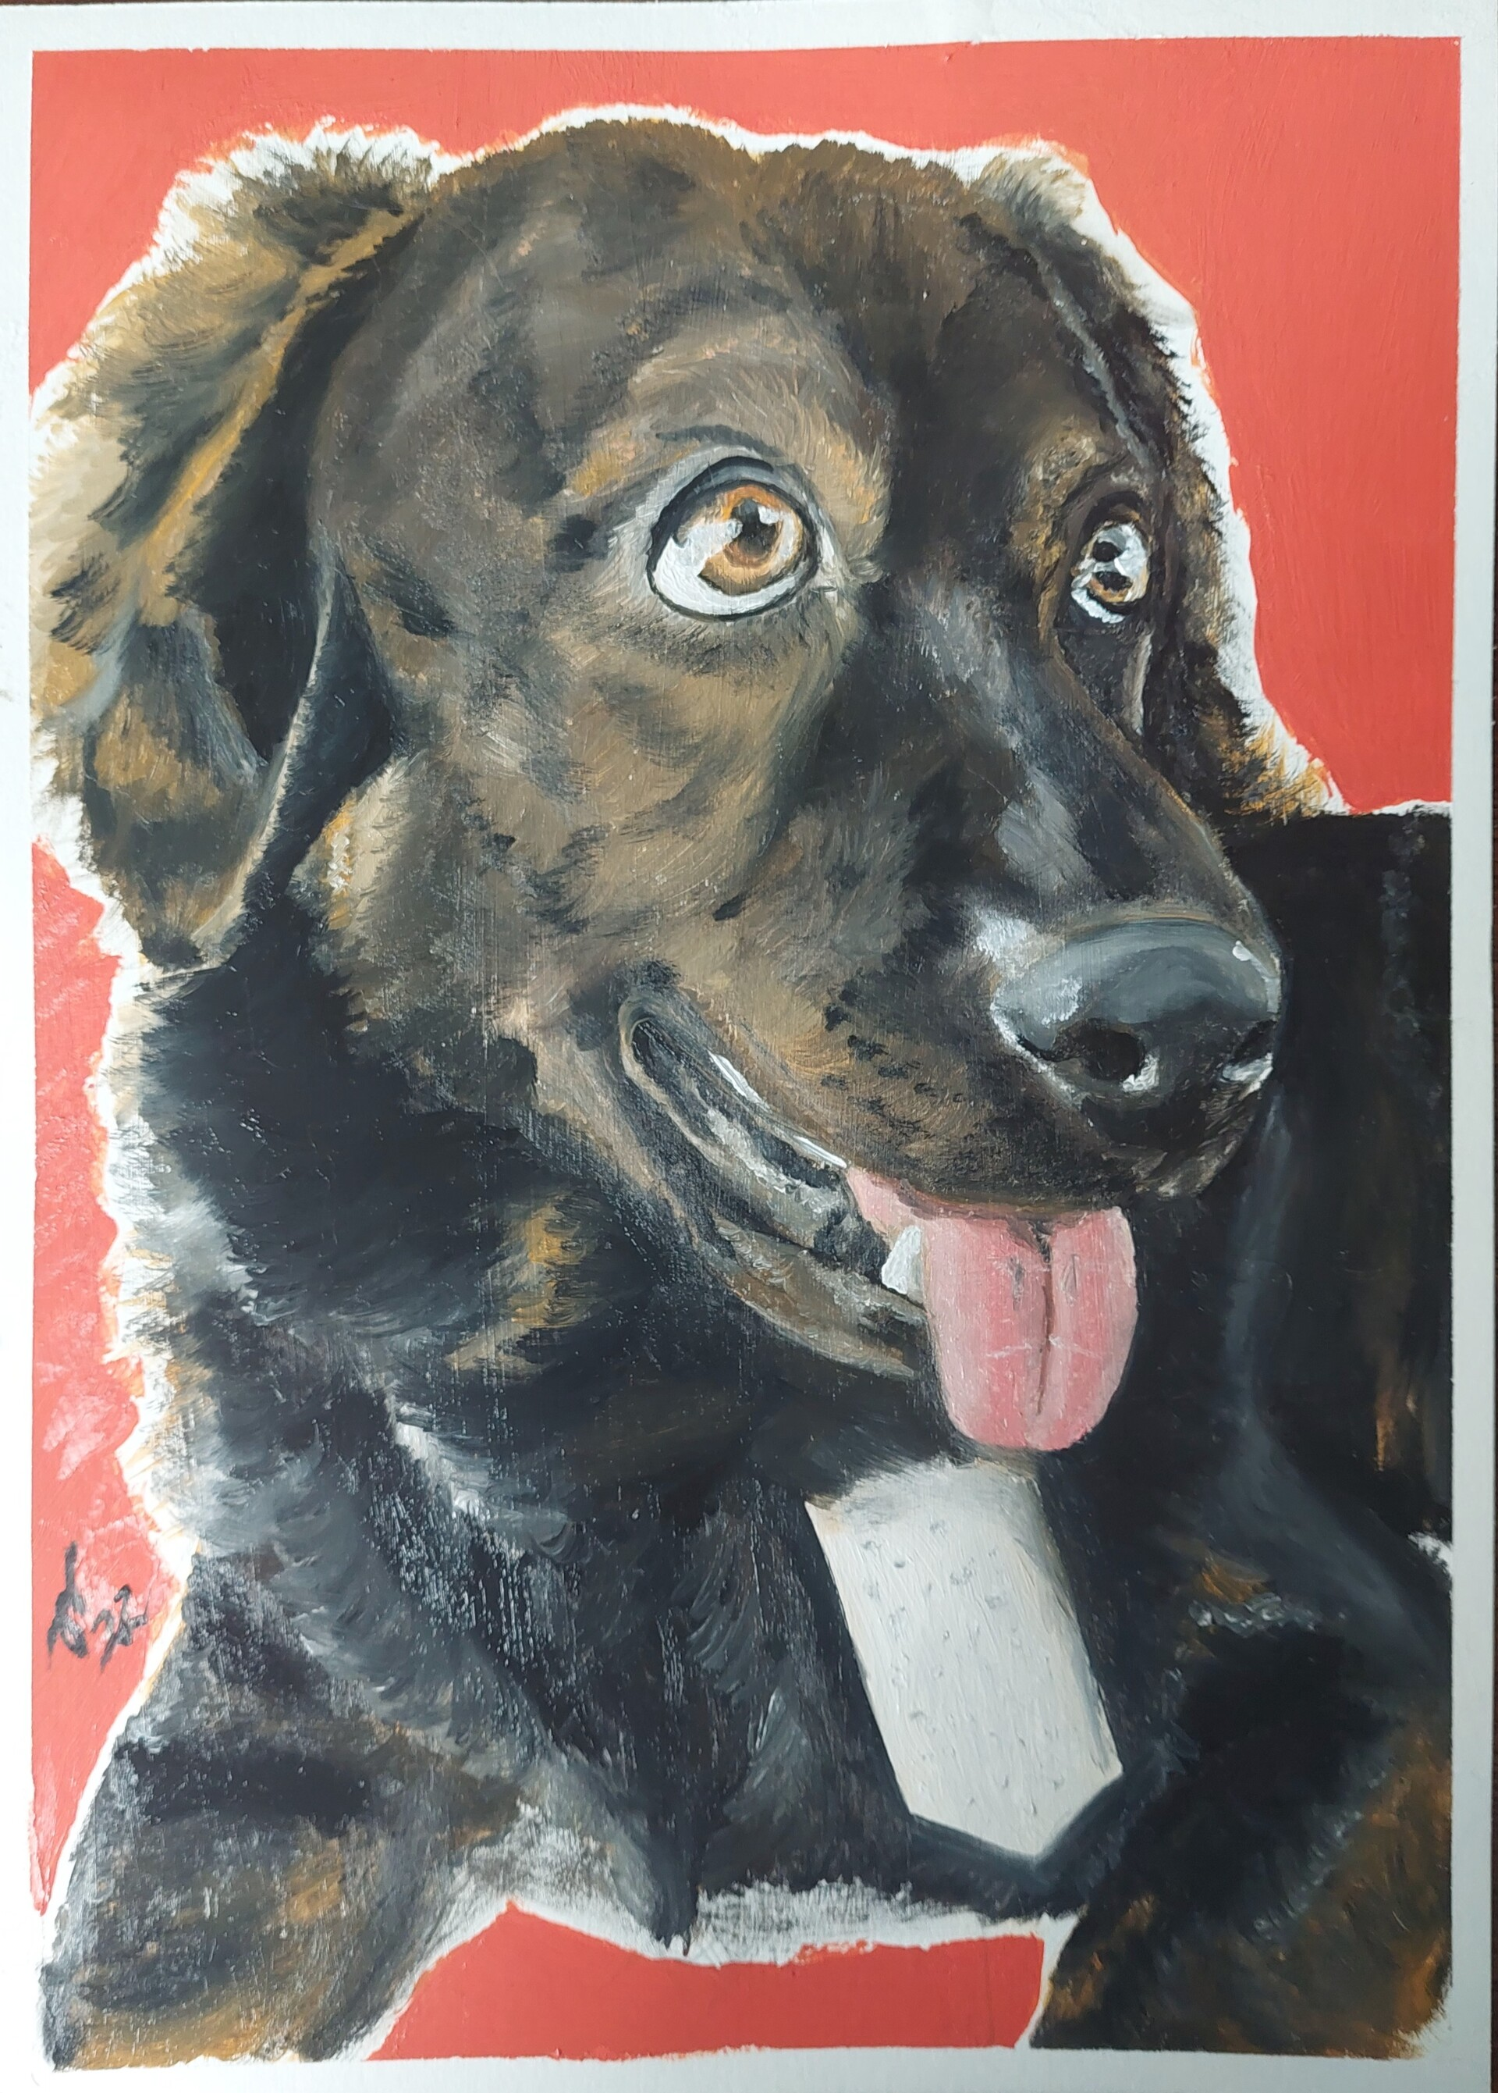
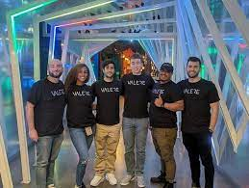
Problems
Emotion: Tender
Content similarity

Slide 6
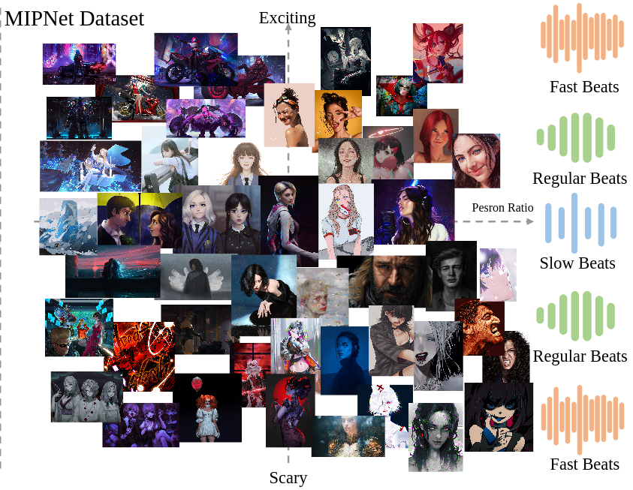





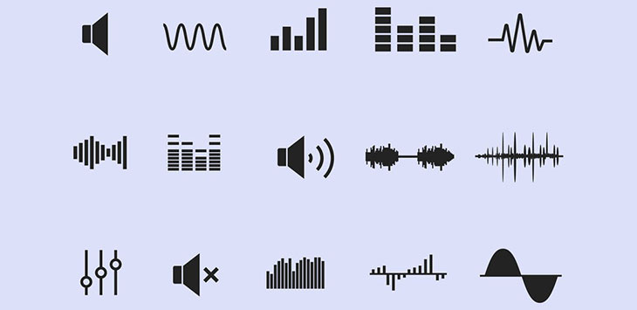



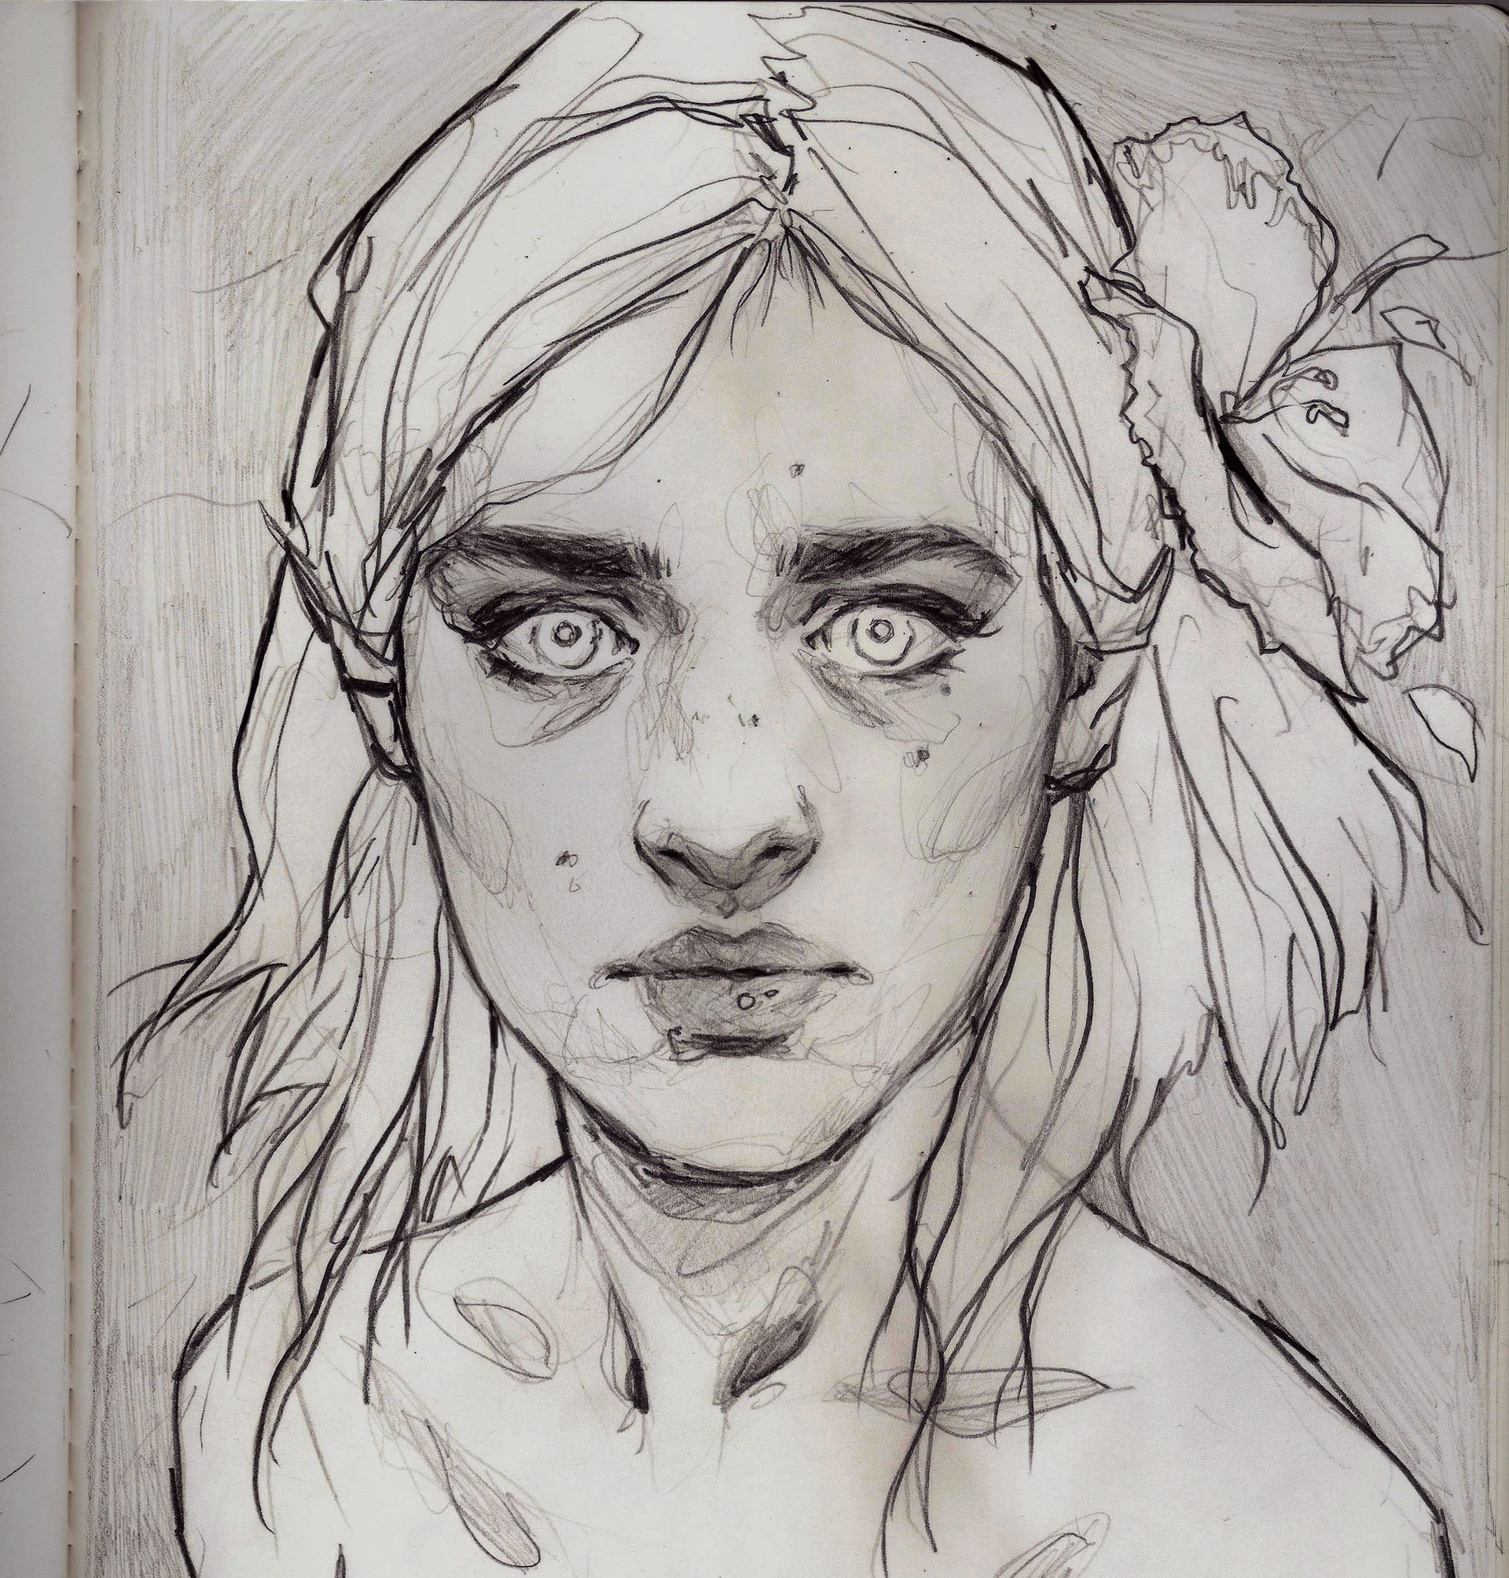
MIPNet Dataset
Collect data：
Downloading music clips (10 seconds) and thumbnails of music videos from online Social Media platforms Youtube and Bilibili, and the emotion labels are pre-annotated by a LLM (e.g.,Qwen-VL) and refined by human annotations
Clean data：
duplication removal
quality filtering
textual filtering
ratio filtering
Emotions: Exciting, Funny, Happy, Tender, Sad, Angry, Scary
66,048 image-music pairs in total
Dataset will be available through an application process following Creative Commons Attribution-NonCommercial (CC BY-NC 4.0) license

Slide 7
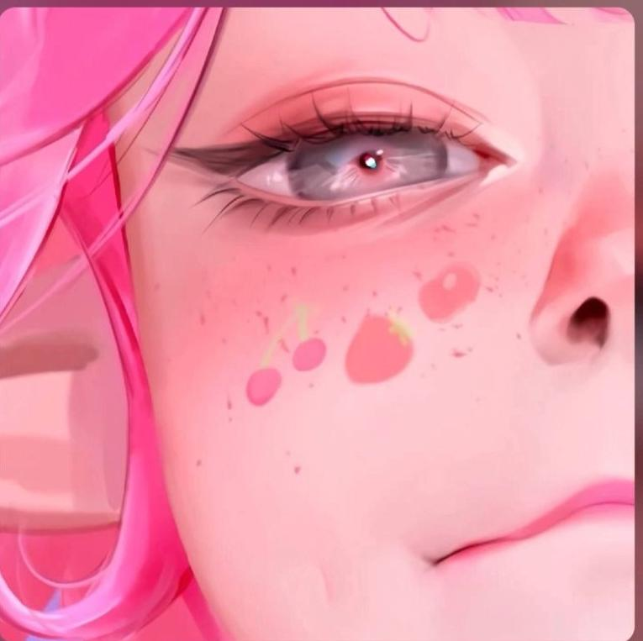



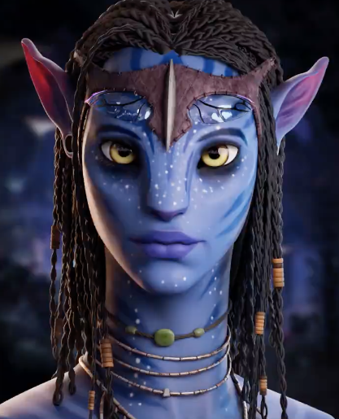

MIPNet Dataset
Image-music pairs in MIPNet Dataset

Slide 8
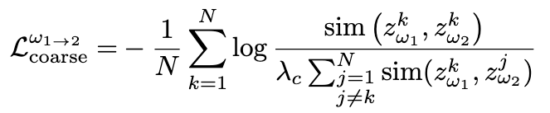
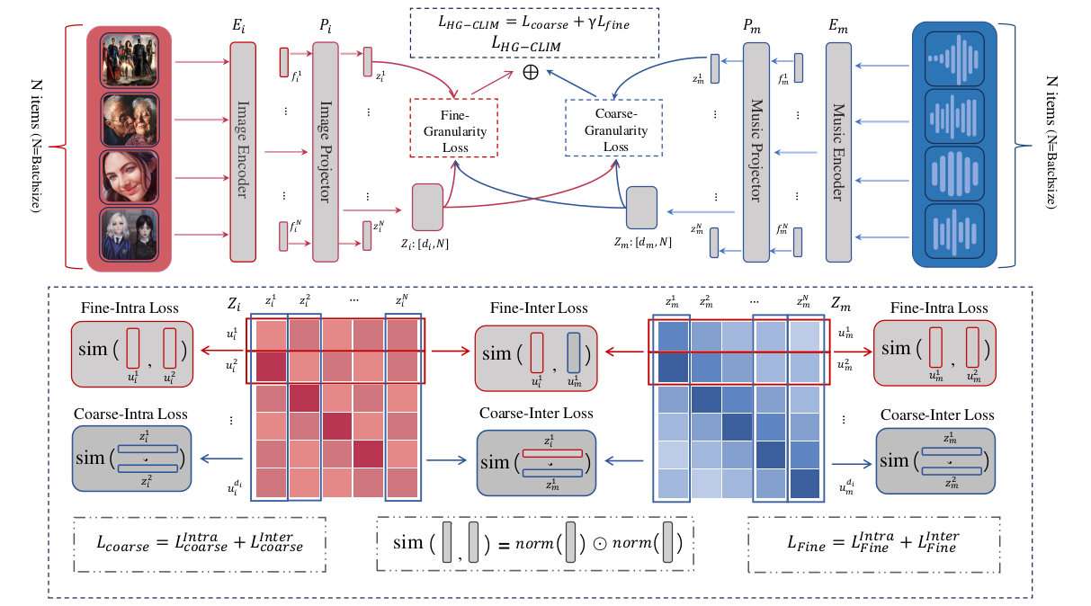
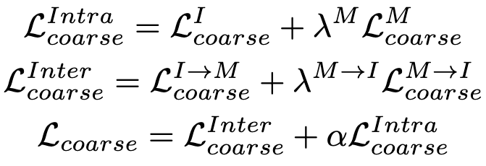
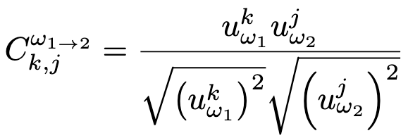
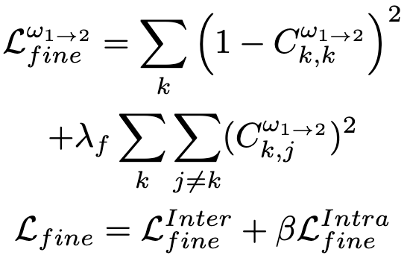


HG-CLIM
where
$λ_{c}=1,λ_{f}$=0.0061,$β=1, γ=0.01$
empirically.

Slide 9
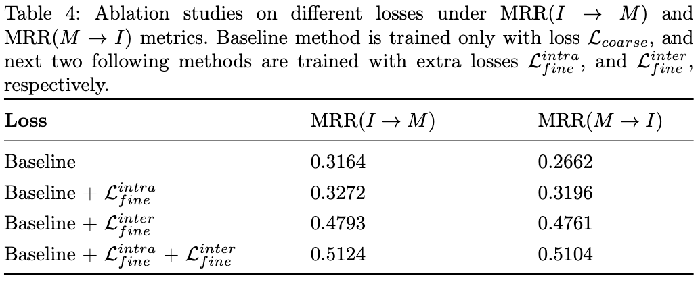
Experiments
Ablation studies

Slide 10
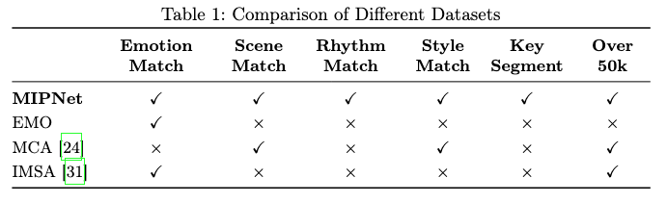
Experiments
Quantitative comparisons

Slide 11
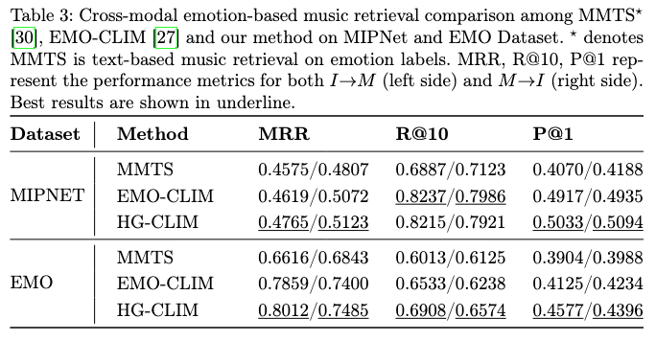
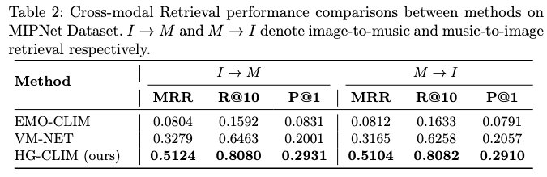
Experiments
Quantitative comparisons

Slide 12



Experiments
qualitative comparisons (image-based music retrieval)
Query
Ours
EMO-CLIM
VM-NET

Slide 13

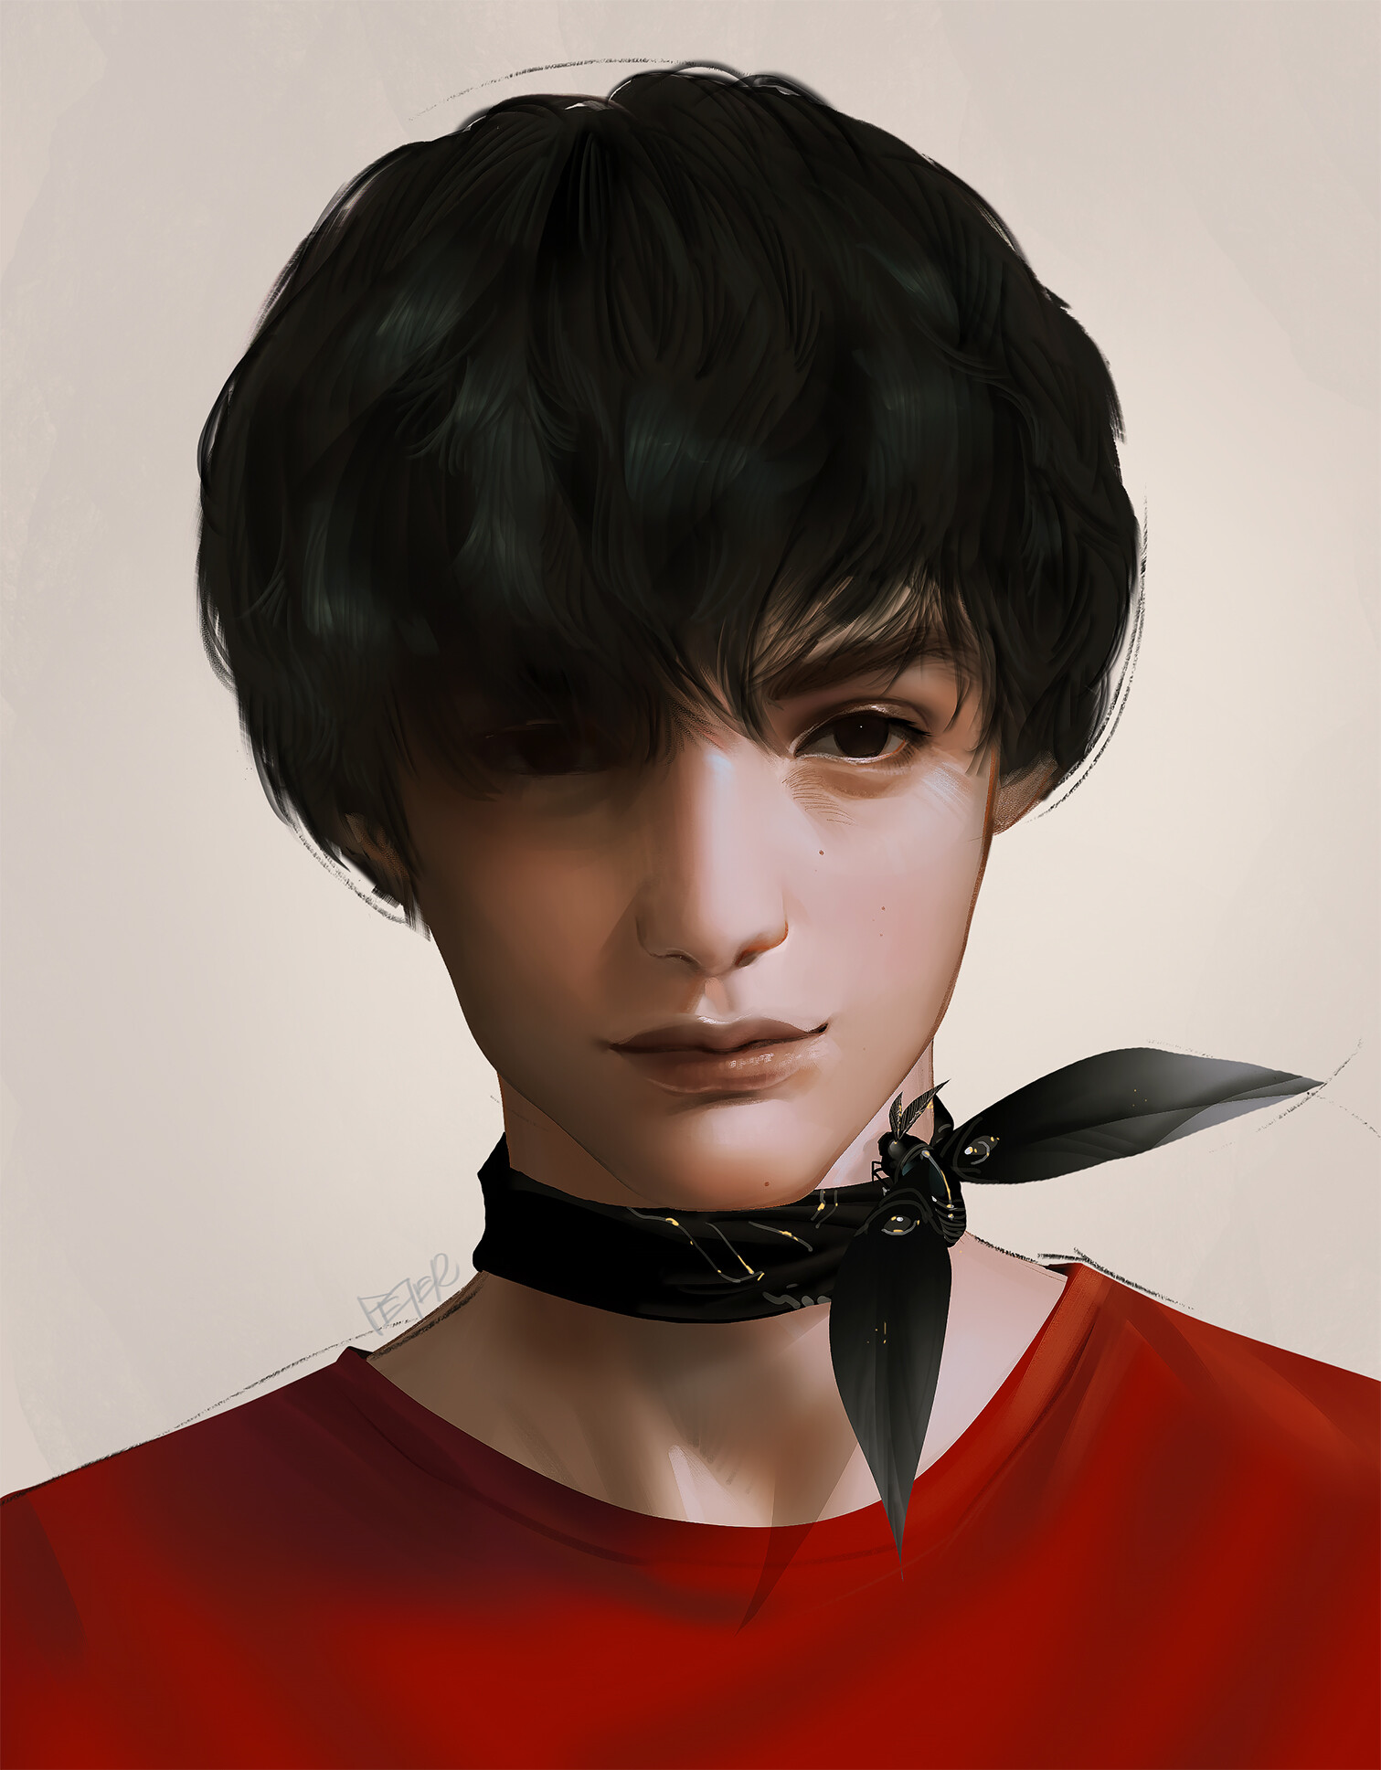
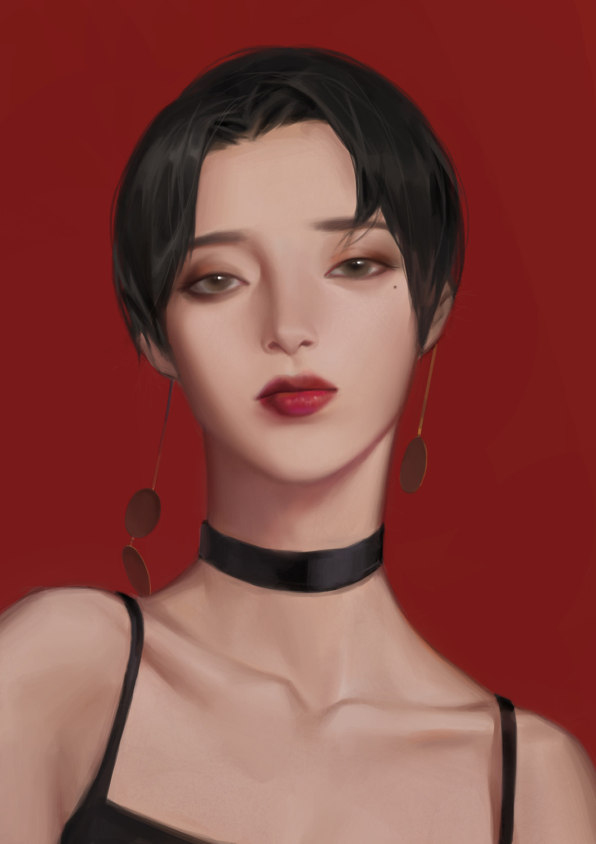
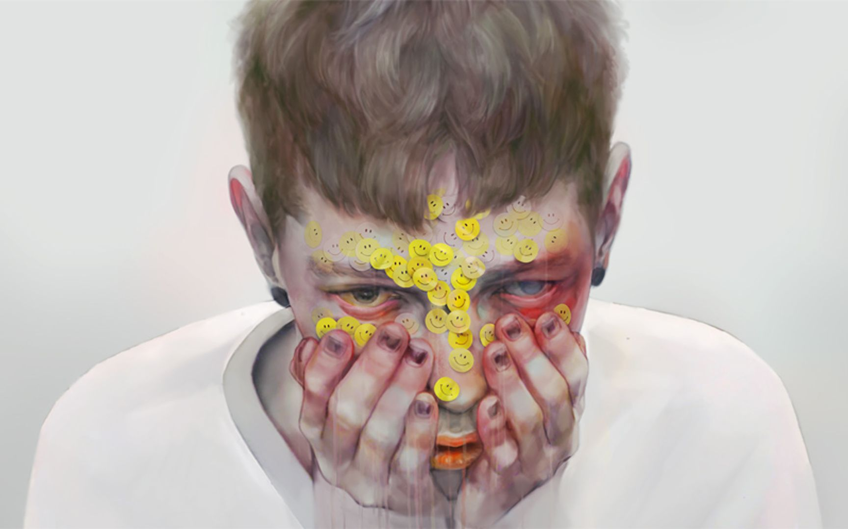




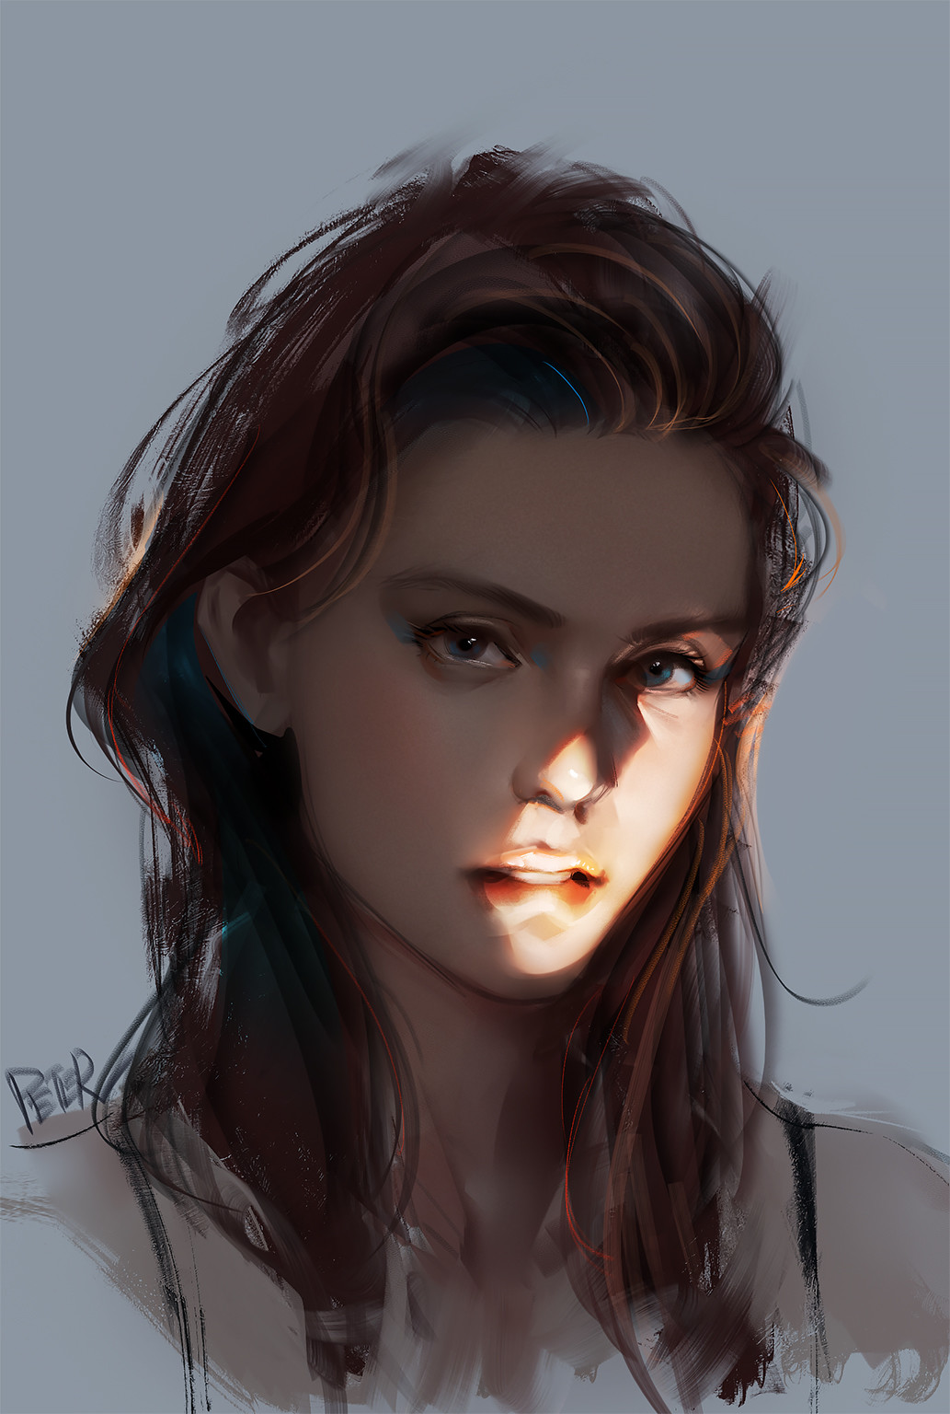
Experiments
qualitative comparisons (music-based image retrieval)
Query
Ours
EMO-CLIM
VM-NET

Slide 14

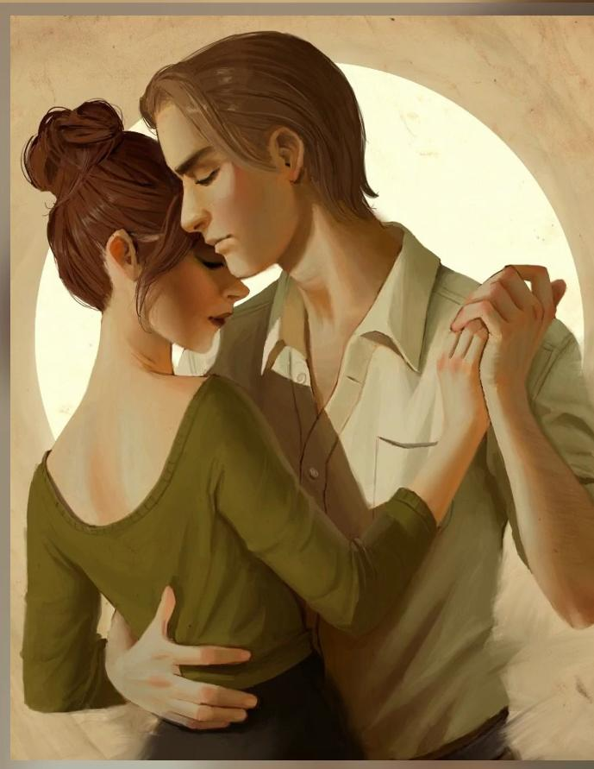




More results
Image-based music retrieval

Slide 15
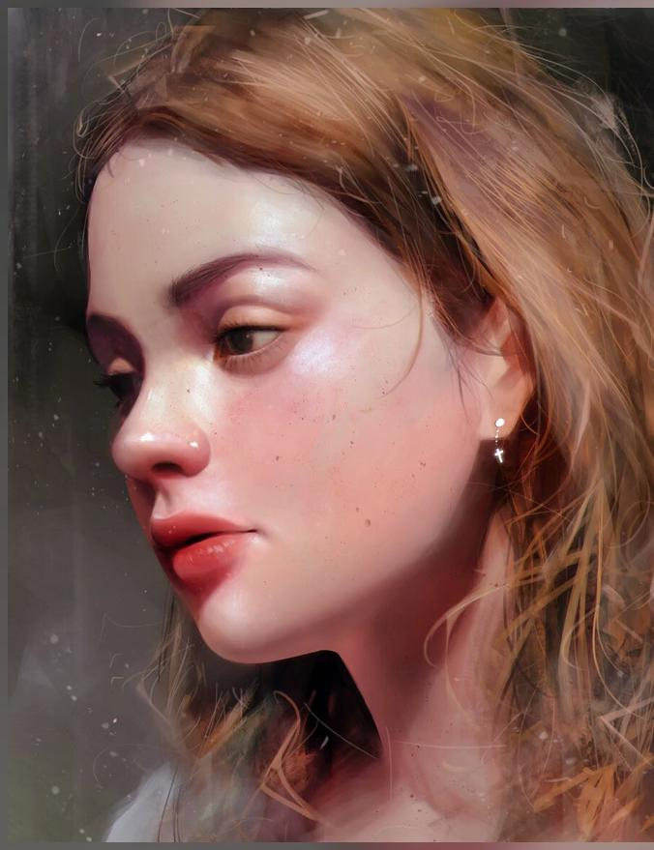


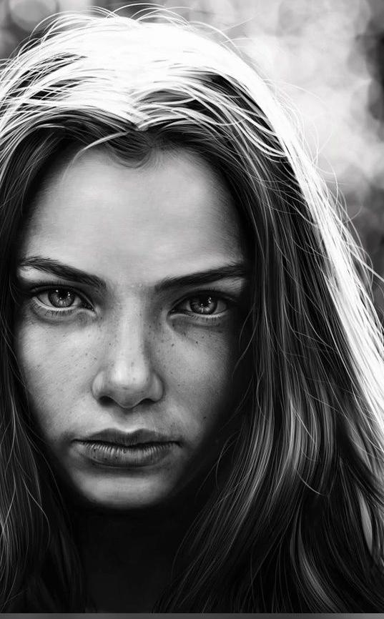


More results
Music-based image retrieval

Slide 16
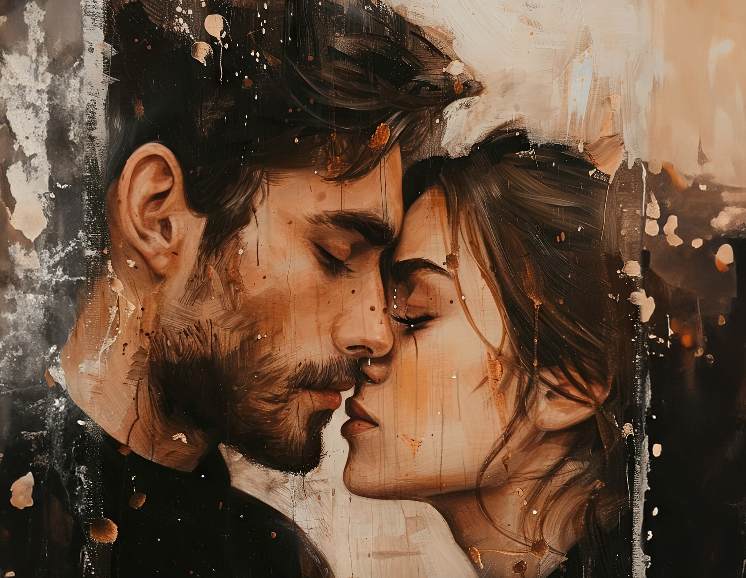

Music Videos
Lyrics

Slide 17

Music Videos
Lyrics

Slide 18

Music Videos
Lyrics

Slide 19
Q & A

